Slide 1
Hunting Dictionary DGAs
Using clustering through connections

Slide 2
DGA Hunting Hypothesis
We hypothesize that domains generated by Dictionary based DGAs will have multiple words in common.
From this hypothesis, it should follow that the underlying word and character structures will be similar.
This implies that if, we have a method for quantifying the amount of connections between two domains, based on shared word and character structures.
It follows that domains from the same dictionary DGA family should have commonalities that can be similarly quantified.

Slide 3
DGA Link Quantification
Our quantification is based on n-grams, where and n-gram is any combination of any n characters.
We used values from 1 to 4 for n. Creating 475254 different n-grams.
We then tested each domain name against each n-gram with the result of the test being the number of times a given n-gram occurs in a word.
This allows us to build a matrix that quantifies the word and character structure of each domain.

Slide 4
Representation of Quantification
We represent our quantification using a matrix (denoted L) where:
      The rows represent domains
      The columns represent n-grams
      The matrix elements quantify the number of times the corresponding n-gram (row) occurs in the corresponding word (column).

Slide 5
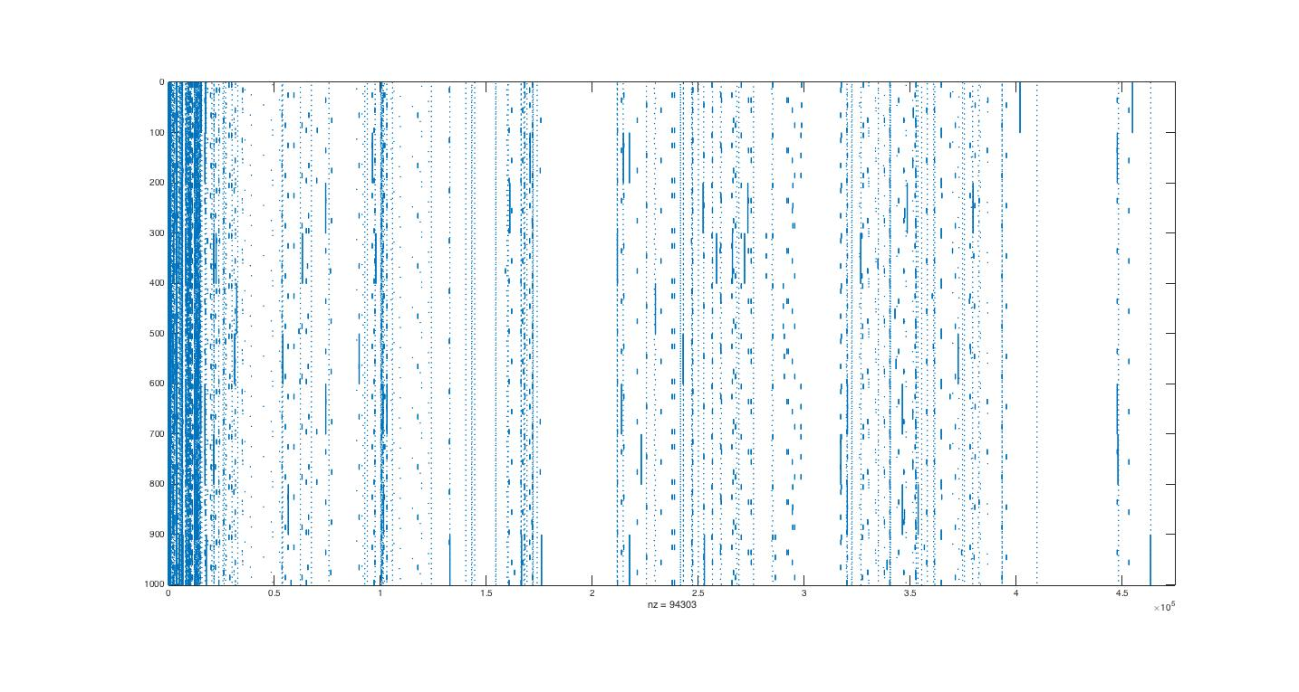
Sample Quantification
d
o
m
a
i
n
s
n-grams

Slide 6
Interpret the Quantification
We now wish to measure the strength of the connections between domains.
This stems from our hypothesis that dictionary DGA based domains will be more strongly connected that other domains on the internet.
We obtain this quantification of the links between domains by right-multiplying the previously generated L by its transpose.
This matrix product represents the strength of the connection between any two domains, as quantified by shared word and character structures.

Slide 7
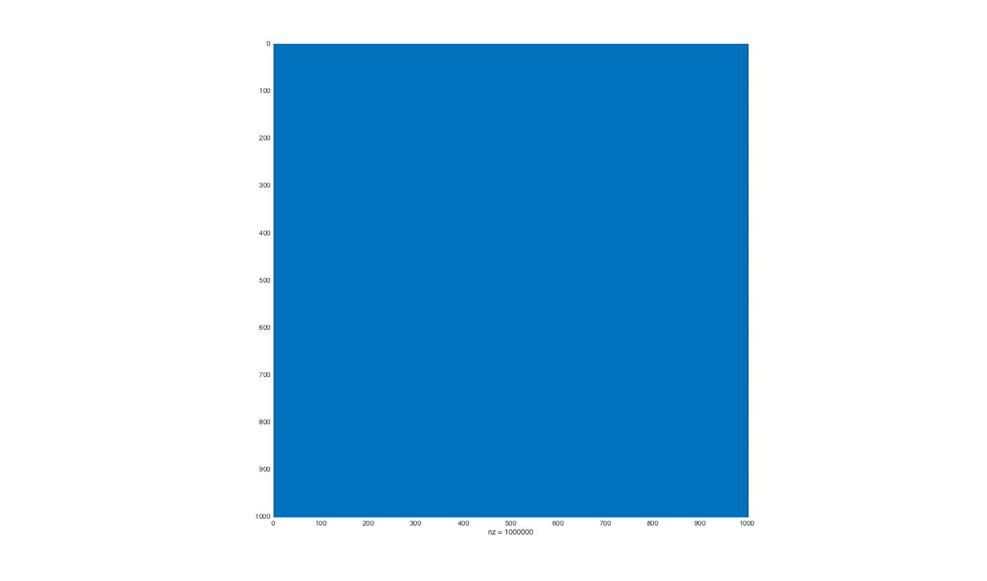
The product and a problem
D
o
m
a
i
n
s
Domains

Slide 8
A Threshold from Training
Clearly, the previous matrix is unusable, so we must specify a minimum value for the connections between domains.
To obtain this value, we need known good data off of which to train our model.
The good data we chose was the top 1000 from the Alexa Top 1-million.
We use this ‘good’ data the same as unknown data, generating the L matrix and computing the product of L with its transpose.

Slide 9
Getting the Threshold
We look for the maximum connection value in the sub-matrix containing the ‘good’ data.
This connection value becomes our threshold.
Connections values above this threshold are considered to belong to ‘bad’ domains.
Connection values below this threshold are considered to belong to ‘good’ domains.
This is applied to the LL^T matrix by zeroing any values less than or equal to the threshold.

Slide 10
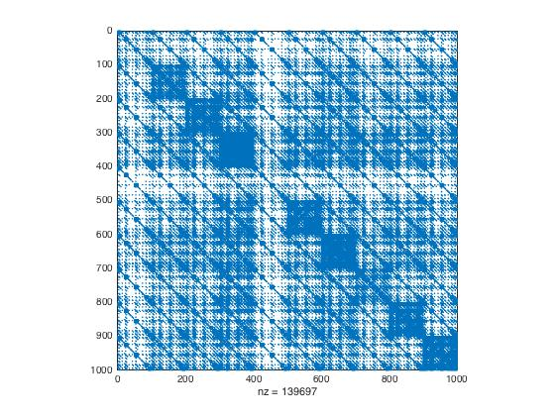
Applying to DGAs only
Domains
D
o
m
a
i
n
s

Slide 11
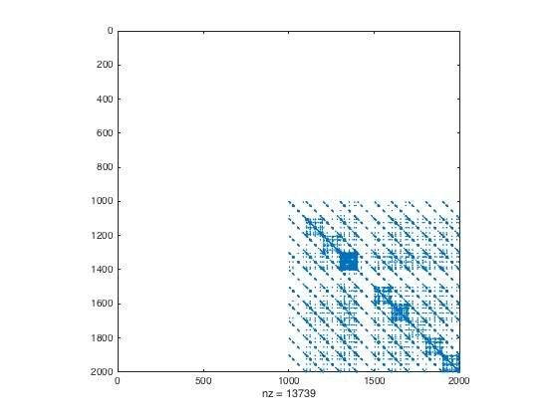
Training Results
Top 1000 are the top 1000 from the Alexa Top 1-million.
The bottom 1000 are a collection of pseudo-DGAs generated along the same lines as dictionary DGAs from the wild.

Slide 12
Advantages
We only have to compute L once for each domain because the set of n-grams is a constant. This is useful because
    the L matrix for the training data need be computed only once
    the precomputed L matrix derived from the training data can be combined with the L matrix computed from the domains to be tested

Slide 13
More Advantages
The computation of the product of L with its transpose is computationally fast compared to other clustering algorithms.
The L matrix should be very sparse, reducing the amount of memory required for storage.
Once the threshold value is applied to the LL^T matrix, it becomes very sparse as well.
The LL^T matrix is symmetric, reducing its computation costs by half.

Slide 14
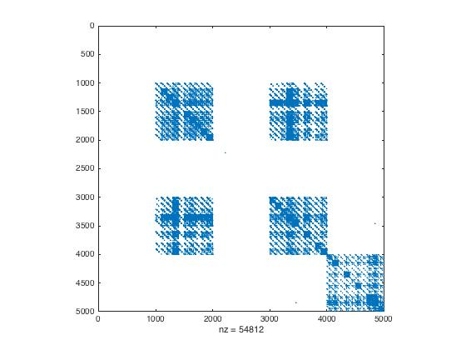
Apply to 2 1/2 DGA families
Alexa top 1000
Pseudo-DGA from (9)
Alexa 1001 to 2000
Reverse of P-DGA from (9)
‘New’ Pseudo-DGA family
*P-DGA = Pseudo-DGA

Slide 15
Results
A zero connection value represents a ‘good’ domain, while a non-zero value represents a ‘bad’ domain.
Low false-positive rate 1/1000 or 0.1%.
Similar DGA families are linked suggesting their shared membership in a malware family.
Differentiation between malware families.
Additional training data should reduce the false positives further.

